Slide 1
HEART FAILURE PREDICTION Supervised Machine Learning: Classification
FEDERICO A. GORRINI

Slide 2
HEART FAILURE
01
background

Slide 3
CARDIOVASCULAR DISEASES
Cardiovascular diseases (CVDs) are a group of disorders affecting the heart and blood vessels, and they are the leading cause of death globally. In 2019, an estimated 17.9 million people died from CVDs, accounting for 32% of all global deaths¹. Of these deaths, 85% were due to heart attacks and strokes¹.
Tracking and predicting CVDs is crucial because early detection and management can significantly reduce the risk of severe complications and death. Over three-quarters of CVD deaths occur in low- and middle-income countries, highlighting the need for accessible healthcare and preventive measures¹. Additionally, in the United States, heart disease is the leading cause of death, with one person dying every 33 seconds from cardiovascular disease².
By addressing behavioral and environmental risk factors such as tobacco use, unhealthy diet, physical inactivity, and air pollution, many cardiovascular diseases can be prevented¹. Therefore, monitoring these risk factors and implementing effective health policies are essential steps towards reducing the global burden of CVDs.
¹ World Health Organization
https://www.who.int/news-room/fact-sheets/detail/cardiovascular-diseases-%28cvds%29
² Centers for Disease Control and Prevention
https://www.cdc.gov/heart-disease/data-research/facts-stats/index.html

Slide 4
CARDIOVASCULAR DISEASES
Preventing CVDs involves addressing the risk factors through lifestyle changes such as:
Healthy Eating: Consuming a balanced diet rich in fruits, vegetables, and whole grains.
Regular Physical Activity: Engaging in at least 150 minutes of moderate-intensity exercise per week.
Avoiding Tobacco: Quitting smoking and avoiding secondhand smoke.
Limiting Alcohol: Reducing alcohol intake to moderate levels ¹.
Early detection and management are crucial. Regular health check-ups can help monitor blood pressure, cholesterol levels, and other indicators of heart health. Medications and medical procedures may also be necessary to manage existing conditions ².
By understanding and addressing the risk factors and symptoms of CVDs, we can significantly reduce the global burden of these diseases and improve overall heart health.
¹ World Health Organization
https://www.who.int/news-room/fact-sheets/detail/cardiovascular-diseases-%28cvds%29
² Centers for Disease Control and Prevention
https://my.clevelandclinic.org/health/diseases/21493-cardiovascular-disease

Slide 5
HEARTH FAILURE
Heart failure, also known as congestive heart failure, is a chronic condition where the heart muscle is unable to pump blood efficiently enough to meet the body's needs ². This can lead to a build-up of fluid in the lungs and other parts of the body, causing symptoms such as shortness of breath, fatigue, and swelling in the legs and ankles ² ³.
Causes of Heart Failure
Heart failure can result from various conditions that damage or overwork the heart, including:
Coronary Artery Disease (CAD): Narrowed or blocked arteries reduce blood flow to the heart muscle.
Heart Attack: A sudden blockage of blood flow to the heart muscle, causing permanent damage.
High Blood Pressure: Forces the heart to work harder than normal, leading to thickening or stiffening of the heart muscle.
Cardiomyopathy: Diseases of the heart muscle due to genetic factors, infections, or alcohol/drug abuse.
Heart Valve Problems: Faulty heart valves force the heart to work harder to pump blood ² ³.
Symptoms of Heart Failure
Shortness of Breath: Especially during physical activity or when lying down.
Fatigue and Weakness: Due to reduced blood flow to muscles and organs.
Swelling (Edema): In the legs, ankles, and feet due to fluid retention.
Rapid or Irregular Heartbeat: As the heart tries to compensate for its reduced pumping ability.
Persistent Cough or Wheezing: Due to fluid build-up in the lungs ² ³.

Slide 6
HEARTH FAILURE
Diagnosis and Treatment
Diagnosing heart failure typically involves a combination of physical exams, imaging tests (such as echocardiograms and MRIs), and blood tests to assess heart function and identify underlying causes ¹ ². Treatment aims to manage symptoms and improve quality of life. It may include:
Medications: Such as ACE inhibitors, beta-blockers, and diuretics to reduce symptoms and prevent further damage.
Lifestyle Changes: Including a heart-healthy diet, regular exercise, quitting smoking, and limiting alcohol intake.
Surgical Procedures: In severe cases, procedures like coronary artery bypass grafting (CABG), heart valve repair/replacement, or heart transplant may be necessary ¹ ².
Prevention
Preventing heart failure involves managing risk factors through:
Regular Health Check-ups: Monitoring blood pressure, cholesterol levels, and other heart health indicators.
Healthy Lifestyle Choices: Maintaining a balanced diet, staying physically active, and avoiding tobacco and excessive alcohol ¹ ².
¹ Mayo Clinic
https://www.mayoclinic.org/diseases-conditions/heart-failure/symptoms-causes/syc-20373142.
² American Heart Association
https://www.heart.org/en/health-topics/heart-failure/what-is-heart-failure.
³ Professional Hearth
https://professional.heart.org/en/health-topics/heart-failure/what-is-heart-failure.

Slide 7
EXPLORATORY DATA ANALYSIS
02

Slide 8
DATASET
Supervised Machine Learning Classification will be implemented to predict heart failure. The dataset used for this analysis, provided by Davide Chicco and Giuseppe Jurman ¹, includes 14 clinical features that are instrumental in predicting mortality due to heart failure:
age The age of the patient in years.
sex The gender of the patient (1 = male, 0 = female).
cp The type of chest pain experienced by the patient: 0: Typical angina; 1: Atypical angina; 2: Non-anginal pain; 3: Asymptomatic
trtbps The patient’s resting blood pressure in mm Hg.
chol The patient’s serum cholesterol level in mg/dl.
fbs Whether the patient’s fasting blood sugar is greater than 120 mg/dl (1 = true, 0 = false).
restecg The results of the patient’s resting electrocardiogram: 0: Normal; 1: Having ST-T wave abnormality (T wave inversions and/or ST elevation or depression of > 0.05 mV); 2: Showing probable or definite left ventricular hypertrophy by Estes’ criteria.
thalachh The maximum heart rate achieved by the patient during exercise.
exng Whether the patient experienced angina induced by exercise (1 = yes, 0 = no).
oldpeak ST depression induced by exercise relative to rest.
slp The slope of the peak exercise ST segment: 0: Upsloping; 1: Flat; 2: Downsloping.
caa The number of major vessels (0-3) colored by fluoroscopy.
thall A blood disorder involving less than normal amounts of an oxygen-carrying protein: 0: Null; 1: Fixed defect (no blood flow in some part of the heart); 2: Normal blood flow; 3: Reversible defect (a blood flow is observed but it is not normal).
heart failure The target variable indicating whether the patient has heart failure (1 = yes, 0 = no).
¹ Chicco D, Jurman G. Machine learning can predict survival of patients with heart failure from serum creatinine and ejection fraction alone. BMC Med Inform Decis Mak. 2020 Feb 3;20(1):16. DOI: 10.1186/s12911-020-1023-5. PMID: 32013925; PMCID: PMC6998201.

Slide 9
OBJECTIVE
Supervised Machine Learning Classification will be implemented to predict heart failure. Based on the data set features, it is pursued the prediction of whether a patient is at risk of heart failure or not, as well as to determine which of the features are more relevant in predicting this event.
The identification of features to prevent heart failure does not only serve the purpose of anticipating it, but it can also help to identify risk factors and prevention treatments in order to prevent it.

Slide 10
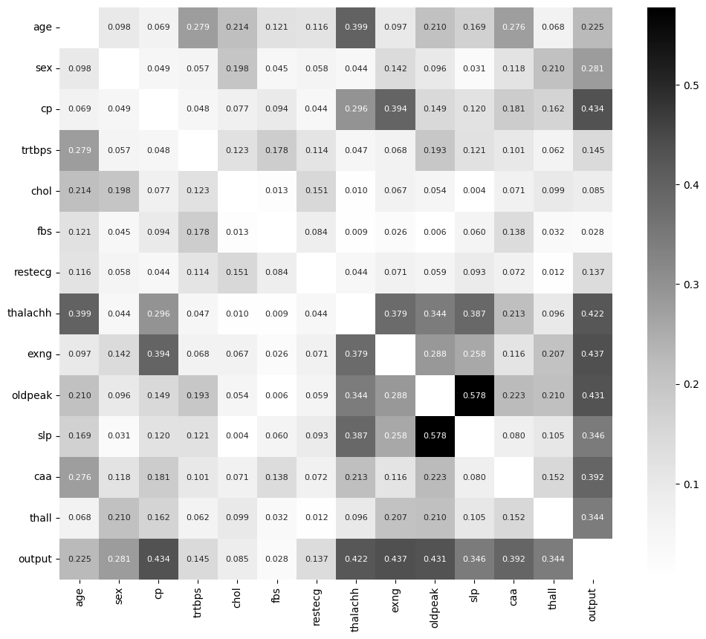
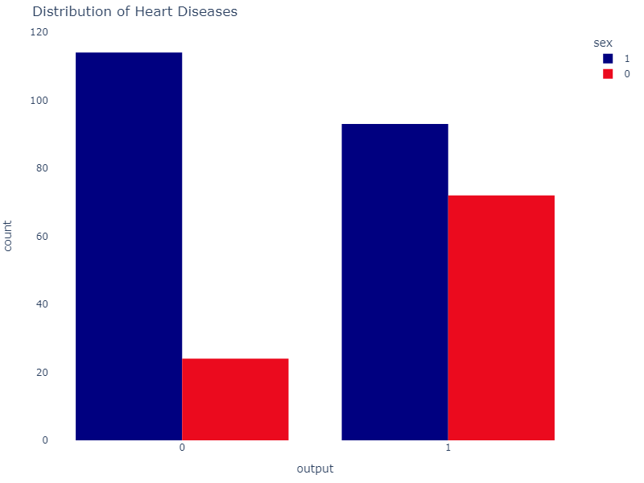
Data exploration - coefficient matrix
Removing correlated variables is crucial for enhancing the model’s performance. You can identify correlations using the pandas .corr() function and visualize the correlation matrix.
Lighter shades indicate a lower absolute correlation.
Darker shades indicate a higher absolute correlation.
Male
Female

Slide 11
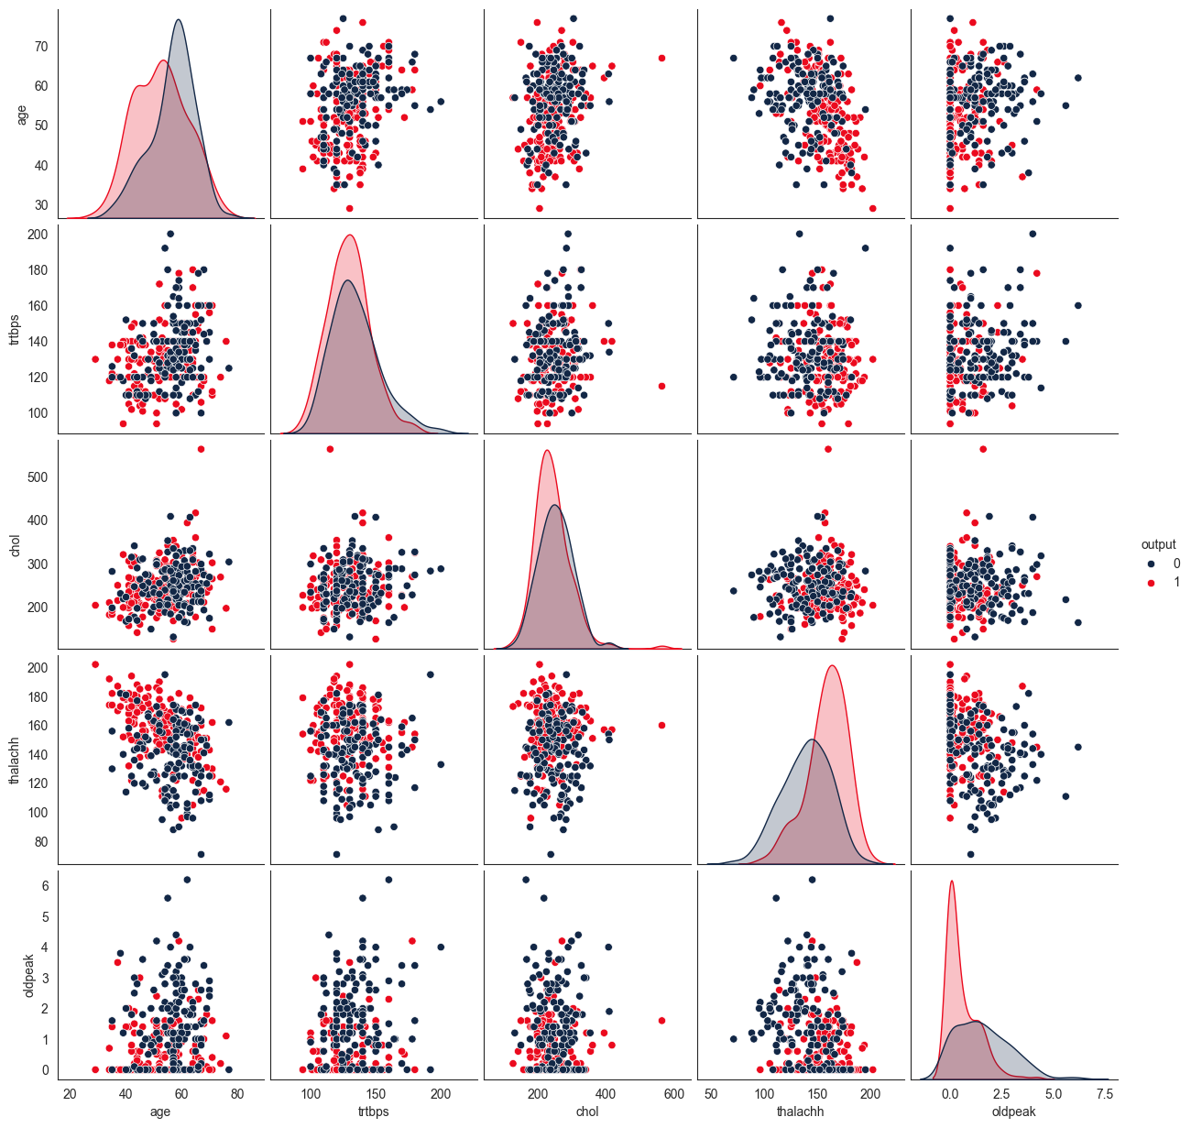
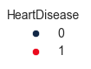
Data exploration - multiple pairwise
bivariate distributions

Slide 12
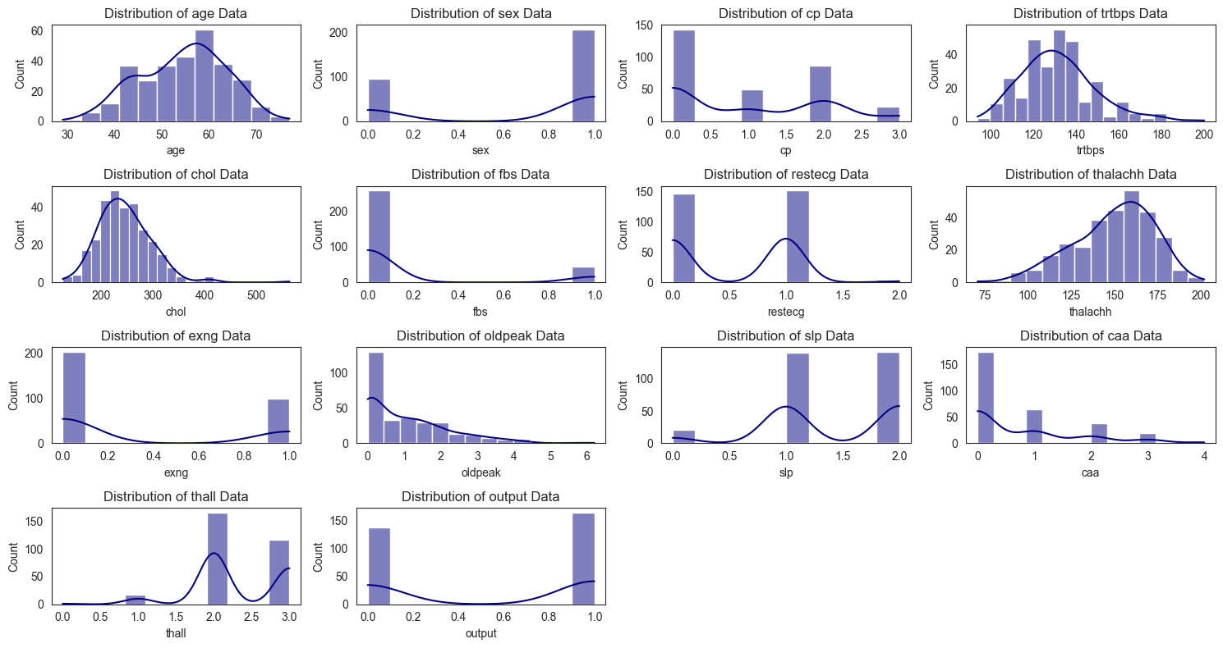
Data exploration - Kernel Density Estimate (SKEWNESS)

Slide 13
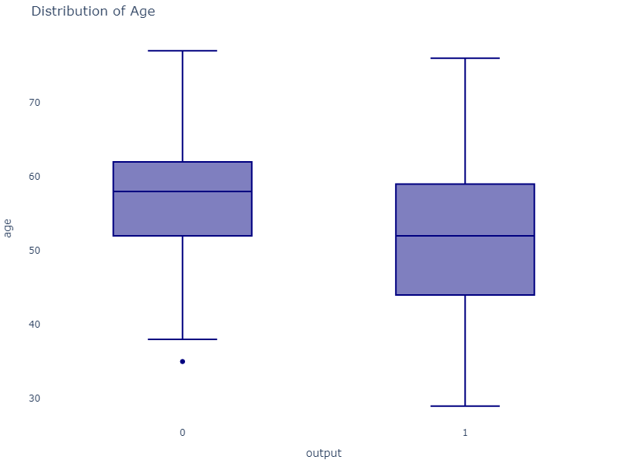
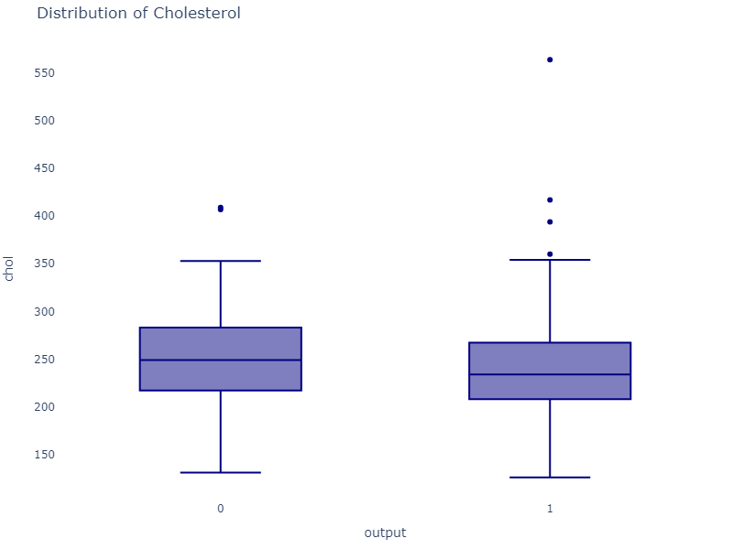
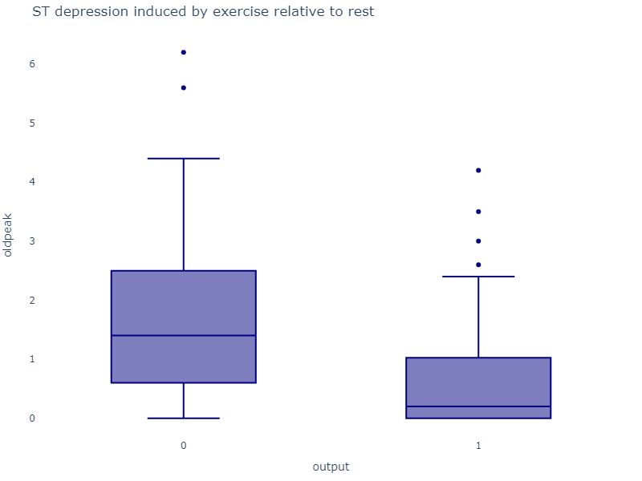
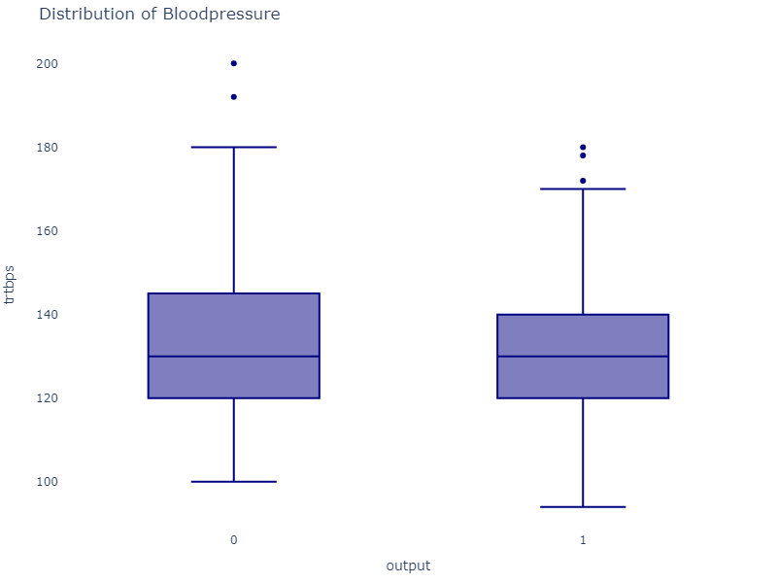
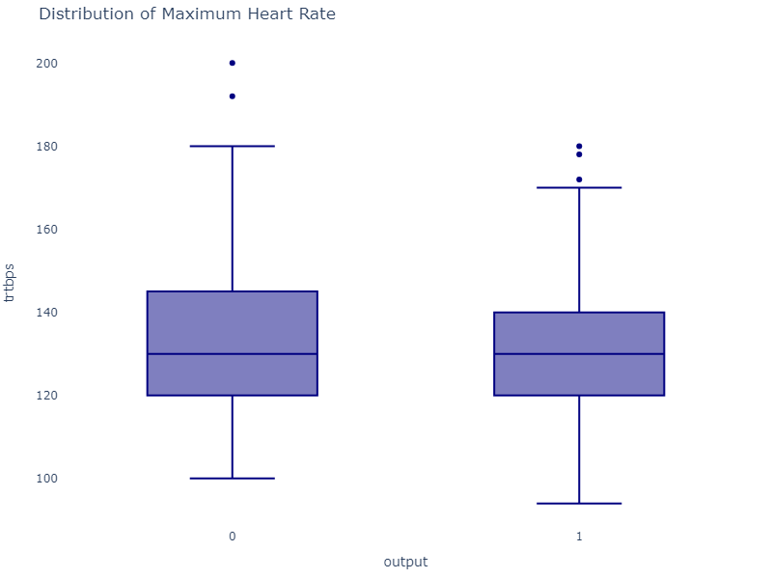
Data exploration - BOXPLOT (OUTLIERS)

Slide 14
Data preprocessing
FEATURE SCALING
The first question we need to address is: why do we need to scale the variables in our dataset? Some machine learning algorithms are sensitive to feature scaling, while others are virtually invariant to it. Let's delve into this in more detail.
DISTANCE-BASED ALGORITHMS
Distance algorithms such as KNN, K-means, and SVM are significantly affected by the range of features. This is because they rely on the distances between data points to determine their similarity. When two features have different scales, there is a risk that features with higher magnitudes will be given more weight. This can negatively impact the performance of the machine learning algorithm, leading to bias towards one feature.
To prevent this, we scale our data before using a distance-based algorithm, ensuring that all features contribute equally to the result.
TREE-BASED ALGORITHMS
Tree-based algorithms, on the other hand, are relatively insensitive to the scale of the features. Consider a decision tree: it splits a node based on a single feature, aiming to increase the homogeneity of the node. This split is not influenced by the scale of other features.
As a result, the remaining features have virtually no effect on the split, making tree-based algorithms invariant to the scale of the features.

Slide 15
Data preprocessing
NORMALIZATION
Normalization is a technique used to adjust and rescale values so that they fall within the range of 0 to 1. This method is also referred to as Min-Max scaling. In this context, Xmax and Xmin denote the maximum and minimum values of the feature, respectively. When X is the minimum value in the column, the numerator becomes 0, resulting in X being 0. Conversely, when X is the maximum value in the column, the numerator equals the denominator, making X equal to 1. If X lies between the minimum and maximum values, then X will be between 0 and 1.
STANDARDIZATION
Standardization is another scaling technique where values are centered around the mean with a unit standard deviation. This implies that the mean of the attribute becomes zero, and the resultant distribution has a unit standard deviation.
QUESTION – NORMALIZE OR STANDARDIZE?
The debate between normalization and standardization is a common one among machine learning practitioners. Here is a detailed explanation:
Normalization is recommended when the distribution of your data does not follow a Gaussian distribution. This can be particularly useful in algorithms that do not assume any distribution of the data, such as K-Nearest Neighbors and Neural Networks.
Standardization, on the other hand, is beneficial when the data follows a Gaussian distribution. However, this is not a strict requirement. Unlike normalization, standardization does not have a bounding range. Therefore, even if outliers are present in your data, they will not be affected by standardization.
In this study, the features have been standardized. There are no missing values and all features are numeric; this means that the categorical features are represented by integers.

Slide 16
MACHINE LEARNING MODELS TRAINING & TESTING
03
RESULTS

Slide 17
MACHINE LEARNING MODELS TRAINING
LOGISTIC REGRESSION
Concept: Logistic Regression is a classification algorithm used to predict the probability of a binary outcome (0 or 1) based on one or more predictor variables.
Working principle: It uses the logistic function (sigmoid) to model the probability of the default class (usually 1). The output is a probability value between 0 and 1, which is then thresholded to make a binary decision.
DECISION TREE
Concept: A Decision Tree is a tree-like model used for classification and regression tasks. It splits the data into subsets based on the value of input features.
Working principle: Starting from the root node, the algorithm selects the best feature to split the data based on a criterion (e.g., Gini impurity, entropy). This process is repeated recursively for each subset until a stopping condition is met (e.g., maximum depth, minimum samples per leaf).
RANDOM FOREST
Concept: Random Forest is an ensemble learning method that combines multiple decision trees to improve the model's accuracy and robustness.
Working principle: It builds multiple decision trees using different subsets of the data and features (bagging). The final prediction is made by averaging the predictions of all the trees (for regression) or by majority voting (for classification).
SUPPORT VECTOR MACHINE (SVM)
Concept: SVM is a classification algorithm that finds the optimal hyperplane to separate data points of different classes.
Working principle: It maximizes the margin between the closest points of the classes (support vectors) and the hyperplane. SVM can also handle non-linear separation by using kernel functions to transform the data into a higher-dimensional space.

Slide 18
MACHINE LEARNING MODELS TRAINING
K-NEAREST NEIGHBORS (KNN)
Concept: KNN is a simple, instance-based learning algorithm used for classification and regression tasks.
Working principle: It classifies a data point based on the majority class of its k-nearest neighbors in the feature space. For regression, it predicts the value based on the average of the k-nearest neighbors.
GRADIENT BOOSTING
Concept: Gradient Boosting is an ensemble learning method that builds a series of weak learners to improve the model's performance.
Working principle: Each new learner is trained to correct the errors made by the previous learners. The model is built in a stage-wise manner, and the final prediction is the weighted sum of the predictions of all the learners.
Type of Models Involved: Typically involves decision trees as the weak learners, but can also use other models such as linear models or neural networks.
XGBOOST
Concept: XGBoost (Extreme Gradient Boosting) is an optimized implementation of gradient boosting that is designed for speed and performance.
Working principle: It uses advanced regularization techniques to prevent overfitting, parallel processing to speed up training, and efficient handling of missing data. XGBoost builds learners sequentially, with each learner correcting the errors of the previous ones.
Type of Models Involved: Typically involves decision trees as the weak learners, but can also use other models such as linear models or logistic regression.

Slide 19
MACHINE LEARNING MODELS TRAINING
ADABOOST
Concept: AdaBoost (Adaptive Boosting) is an ensemble learning method that combines multiple weak learners to create a strong learner.
Working principle: It assigns weights to each training instance and adjusts them based on the errors made by the previous learners. Misclassified instances get higher weights, and the final prediction is a weighted sum of the predictions of all the learners.
Type of Models Involved: Typically involves decision stumps (single-level decision trees) as the weak learners, but can also use other models such as decision trees with more depth or even linear classifiers.
NAIVE BAYES
Concept: Naive Bayes is a probabilistic classification algorithm based on Bayes' theorem, assuming independence between features.
Working principle: It calculates the posterior probability of each class given the input features and selects the class with the highest probability. Despite the independence assumption, Naive Bayes often performs well in practice. Naive Bayes itself is a family of probabilistic algorithms based on Bayes’ theorem. It doesn’t use other models within it but rather relies on the assumption of independence between features. The main types of Naive Bayes models:
Gaussian Naive Bayes: Used when the features are continuous and assumed to follow a normal (Gaussian) distribution. Commonly used for numerical data.
Multinomial Naive Bayes: Used for discrete data, particularly for text classification problems where the features represent the frequency of words. Suitable for counting data.
Bernoulli Naive Bayes: Used for binary/boolean features. Suitable for binary data, such as text classification with binary term occurrence.

Slide 20
MACHINE LEARNING MODELS TRAINING
MLP NEURAL NETWORK
Concept: Multi-Layer Perceptron (MLP) is a type of artificial neural network that consists of multiple layers of nodes, each layer fully connected to the next one. It is commonly used for classification tasks. Key Components: Input Layer: A) This layer receives the input features; B) Hidden Layers: These layers perform computations and extract features from the input data. An MLP can have one or more hidden layers; and C) Output Layer: This layer produces the final output, which can be a class label in the case of classification tasks.
Working Principle:
Forward Propagation: The input features are fed into the input layer. Each node in the hidden layers computes a weighted sum of the inputs, applies an activation function – e.g., ReLU, sigmoid; and passes the result to the next layer.
This process continues until the output layer is reached, producing the final output.
Activation Functions: Activation functions introduce non-linearity into the network, allowing it to learn complex patterns. Common activation functions include ReLU (Rectified Linear Unit), sigmoid, and tanh.
Loss Function: The loss function measures the difference between the predicted output and the actual target values. Common loss functions for classification tasks include cross-entropy loss.
Backpropagation: During training, the network uses backpropagation to update the weights. The gradient of the loss function with respect to each weight is computed, and the weights are adjusted using an optimization algorithm; e.g., stochastic gradient descent.
Training: The network is trained on a dataset by iteratively adjusting the weights to minimize the loss function. The training process continues until the network converges or reaches a specified number of iterations.

Slide 21
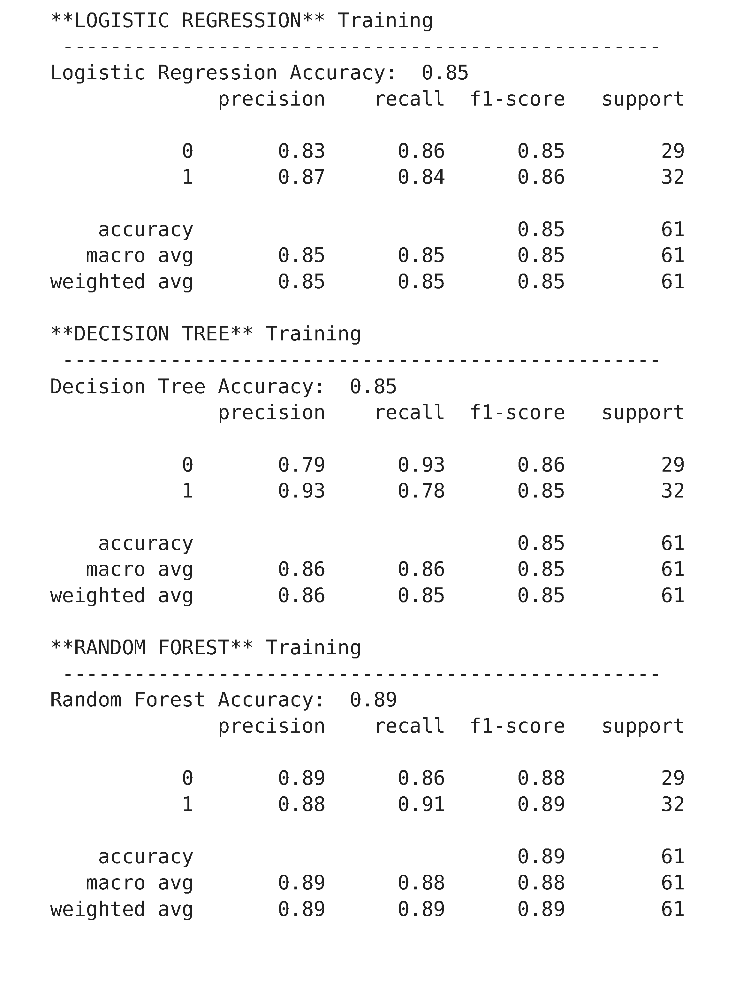
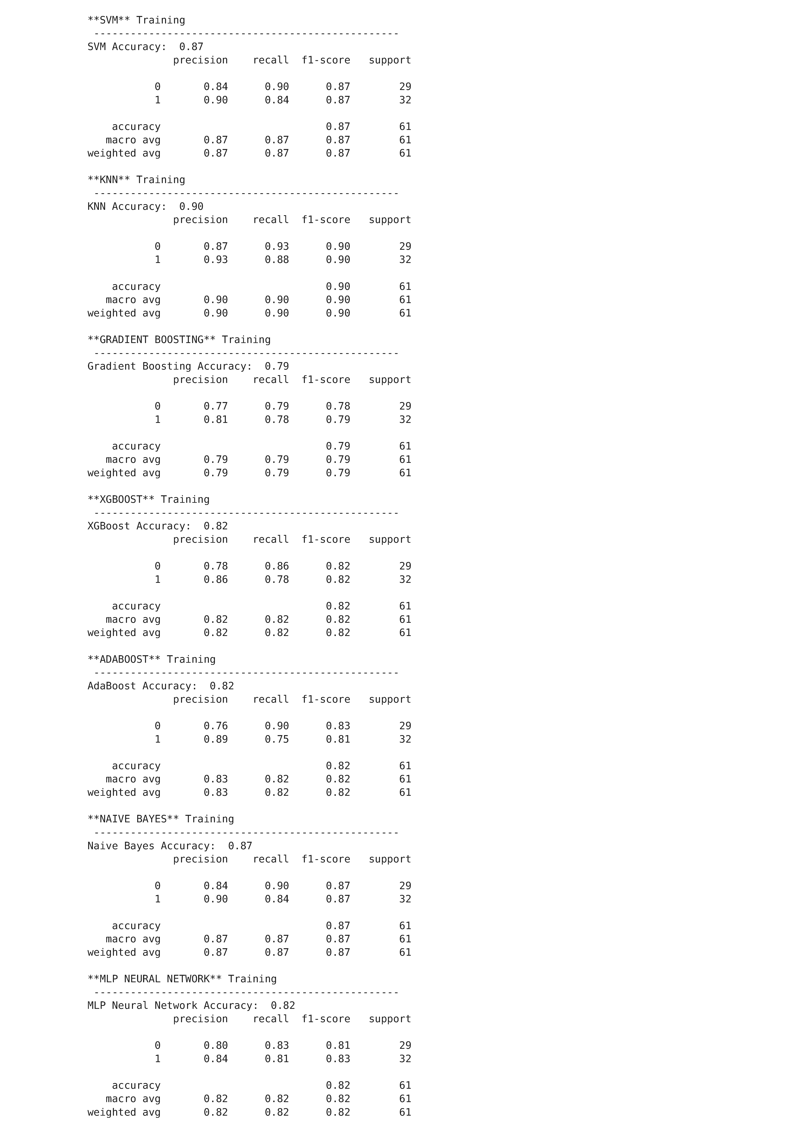
MACHINE LEARNING MODELS TRAINING
PRECISION | RECALL | F1-SCORE | ACCURACY

Slide 22
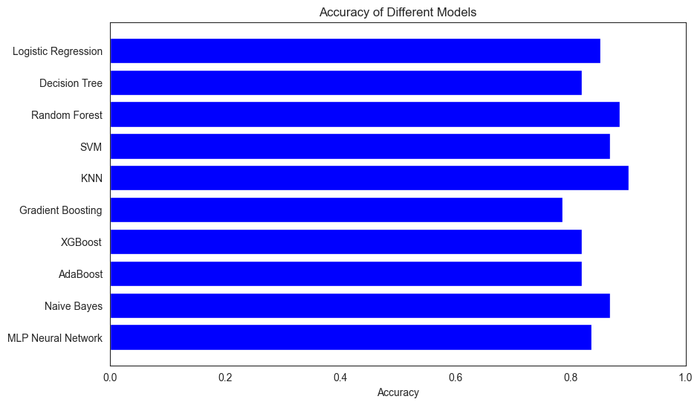
MACHINE LEARNING MODELS TRAINING
MACHINE LEARNING MODEL | ACCURACY
Logistic Regression | 0.852
Decision Tree | 0.803
Random Forest | 0.869
Support Vector Machine (SVM) | 0.869
K-Nearest neighbor (KNN) | 0.902
Gradient Boosting | 0.787
XGBoost | 0.820
AdaBoost | 0.820
Naïve Bayes | 0.869
MLP Neural Network | 0.836

Slide 23
CONCLUSIONS
04

Slide 24
CONCLUSIONS
1. K-Nearest Neighbors (KNN) achieved the highest accuracy of 0.90.
KNN performed well likely because it is a non-parametric method that makes few assumptions about the data distribution. It works well with smaller datasets and can capture complex relationships between features and the target variable.
2. Random Forest and Support Vector Machine (SVM) both achieved an accuracy of 0.87.
Random Forest: This model benefits from ensemble learning, combining multiple decision trees to reduce overfitting and improve generalization. It can handle both numerical and categorical data effectively.
SVM: SVM is effective in high-dimensional spaces and works well with a clear margin of separation. It is robust to overfitting, especially in high-dimensional space.
3. Naive Bayes also performed well with an accuracy of 0.87.
Naive Bayes assumes independence between features, which might be a reasonable approximation for this dataset. It is also very efficient and works well with small datasets.

Slide 25
CONCLUSIONS
4. Logistic Regression and MLP Neural Network had accuracies of 0.85 and 0.84, respectively.
Logistic Regression: This model is simple and interpretable, and it works well when the relationship between the features and the target is approximately linear.
MLP Neural Network: This model can capture non-linear relationships and interactions between features, but it may require more data and tuning to achieve higher performance.
5. Decision Tree, XGBoost, and AdaBoost all had accuracies of 0.82.
Decision Tree: While interpretable, decision trees can overfit the training data, especially with small datasets.
XGBoost: This model is powerful and can handle complex relationships, but it may require careful tuning and more data to perform optimally.
AdaBoost: This model combines weak learners to create a strong learner, but it can be sensitive to noisy data and outliers.
6. Gradient Boosting had the lowest accuracy of 0.79.
Gradient Boosting can be prone to overfitting, especially with small datasets. It also requires careful tuning of hyperparameters to achieve optimal performance.

Slide 26
Improvement Points
Feature Engineering: Consider creating new features or transforming existing ones to capture more information from the data. For example, you could create interaction terms or polynomial features.
Hyperparameter Tuning: Use techniques like Grid Search or Random Search to find the optimal hyperparameters for each model. This can significantly improve model performance.
Ensemble Methods: Combine multiple models to create an ensemble model. Techniques like stacking, bagging, or boosting can help improve overall performance.
Cross-Validation: Ensure you are using cross-validation to evaluate your models. This helps in getting a more reliable estimate of model performance.
Data Augmentation: If possible, augment your dataset to create more training examples. This can help improve model generalization.
Regularization: For models like Logistic Regression and SVM, consider adding regularization to prevent overfitting.
Model Interpretability: Use techniques like SHAP (SHapley Additive exPlanations) or LIME (Local Interpretable Model-agnostic Explanations) to understand which features are most important for your models' predictions.

Slide 27
PHYTON PROGRAMMING
05

